Slide 1

Film Data Analysis for Strategic Industry Launch
Group 2 Project

Slide 2
Overview
1
2
3
4
5
Business Understanding
Key Objectives
Exploratory Data Analysis
Recommendations
Next Steps and Conclusion

Slide 3

Business Understanding
Our company is launching a movie studio to tap into the growing demand for original content.
This project aims to provide actionable insights with the use of data analytics to guide the decision for a successful industry entry despite limited production experience.

Slide 4
Key Objectives:
To identify the film genres with the best critical reception.
To identify the genres that offer the highest return on investment (ROI).
Identify languages and production markets that are most commonly associated with popular, high-grossing films.
Identify directors whose films consistently perform well internationally.

Slide 5

Business Value
Benefits to our organization:
Data-Driven Decisions – Reduces risk and boosts ROI by backing choices with solid data.
Operational Efficiency – Speeds up decision-making and lets teams focus on high-impact projects.
Competitive Edge – Differentiates us in the market through smart, data-led strategies.
Investor Confidence – Builds trust with stakeholders, helping attract new investment.

Slide 6


Data Sources
Box Office Mojo – Shows the Worldwide gross earnings and box office breakdowns
IMDb - Cross-referenced metadata: genres, actors, directors
Rotten Tomatoes - Critic scores, audience ratings, review sentiment
TheMovieDB (TMDB)- Metadata: genres, languages, production countries, popularity
The Numbers- Financial data: budgets, revenues, profit estimates
Together, these datasets offer a comprehensive view of the global film landscape.

Slide 7
Exploratory Data Analysis
To address the key objectives of our project, our analysis was structured around;
Overview of Movie Data
We began by exploring the dataset to understand overall industry performance, focusing on the most common genres and languages to identify key trends.
2. Return on Investment
We analyzed financial metrics such as gross earnings and production budgets, to determine what drives a movie’s financial success.
3. Language and Market Dynamics
We examined the relationship between film languages, their target markets, and overall performance to see how these factors influence success.
4. Creative Talent Impact
By comparing directors to global box office earnings, we assessed how much influence they have on a film’s financial outcomes.
5. Audience Reception
We studied genre popularity and ratings to gain insights into viewer preferences, helping guide future content decisions for the studio.

Slide 8
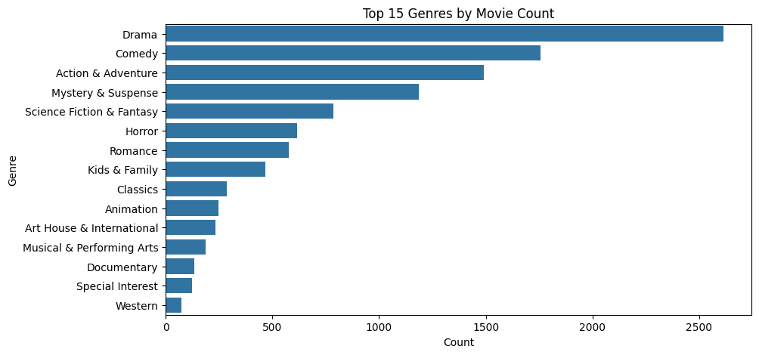
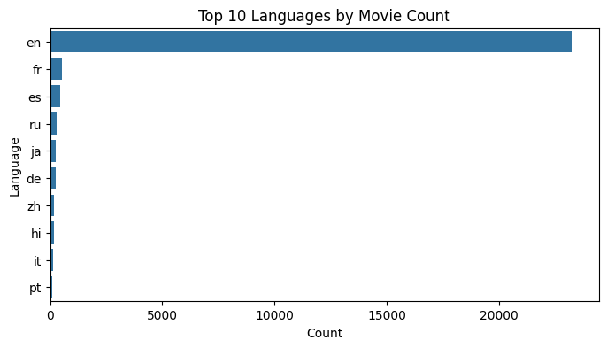
Overview of Movie Data:
Drama, Comedy, Action & Adventure, and Mystery & Suspense are the most common genres in the dataset, indicating a strong industry focus on these categories.
English is by far the dominant language for movies, followed by French, Spanish, Russian, and Japanese.
This reflects both the global reach of English-language films and the presence of strong regional film industries.

Slide 9
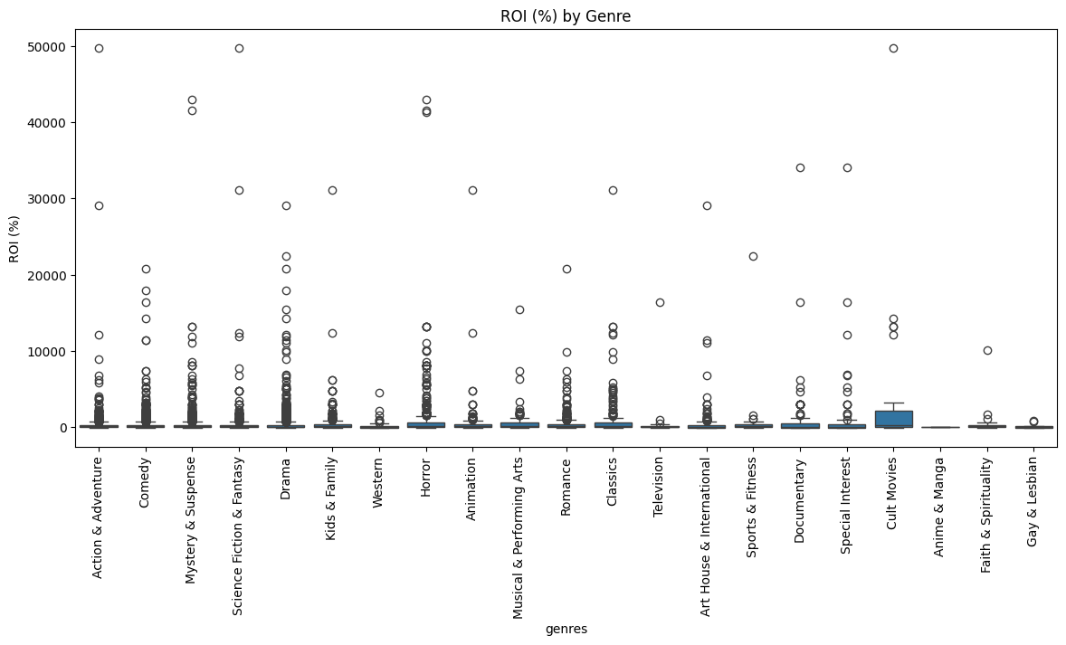
Relationship between Genre and ROI
Return on Investment:
Cult Movies, Horror, and Special Interest genres show the highest average ROI driven by niche audiences.
More common genres like Action & Adventure and Comedy have lower average ROI, possibly due to higher production budgets.

Slide 10
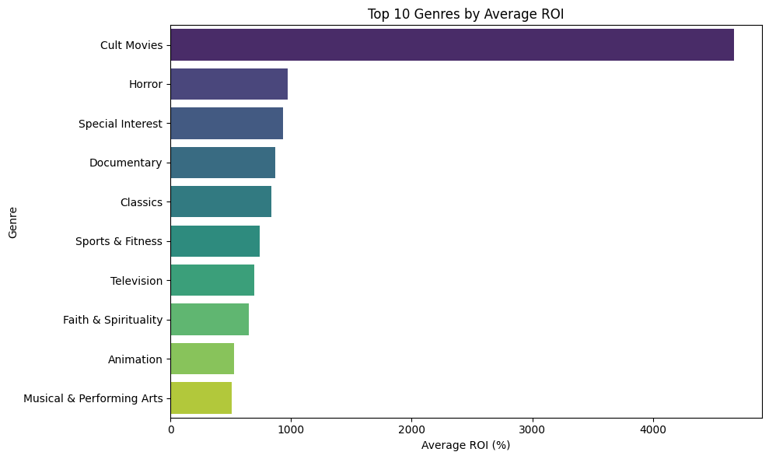
Top 10 Genres by ROI
This shows that low to mid budget movies tend to have a higher ROI compared to high budget movies which did not even make it to the top 10 genres.

Slide 11

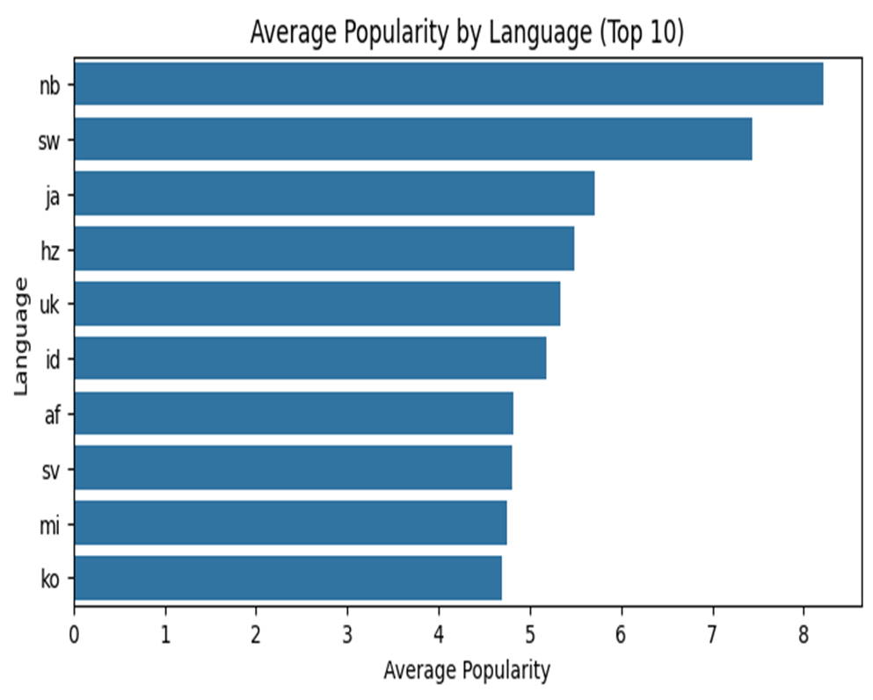
Relationship between Language and Popularity
Language and Market Dynamics:
English is by far the dominant language for movies, followed by French, Spanish, Russian, and Japanese.
This reflects both the global reach of English-language films and the presence of strong regional film industries.
English-language films are the most popular, but some non-English languages (e.g., Japanese, Korean, Swedish) also show high average popularity

Slide 12
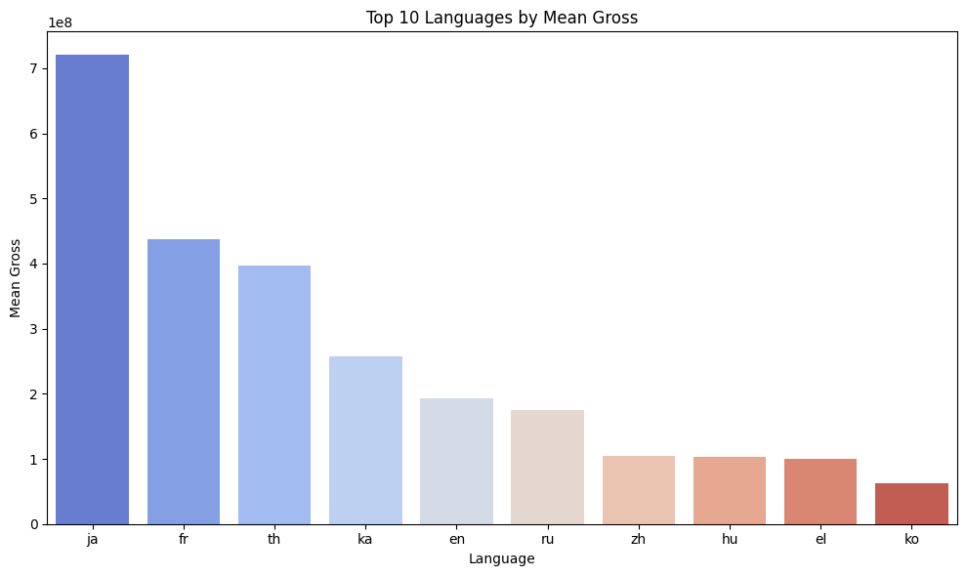
Top 10 Languages by Mean Gross

Slide 13
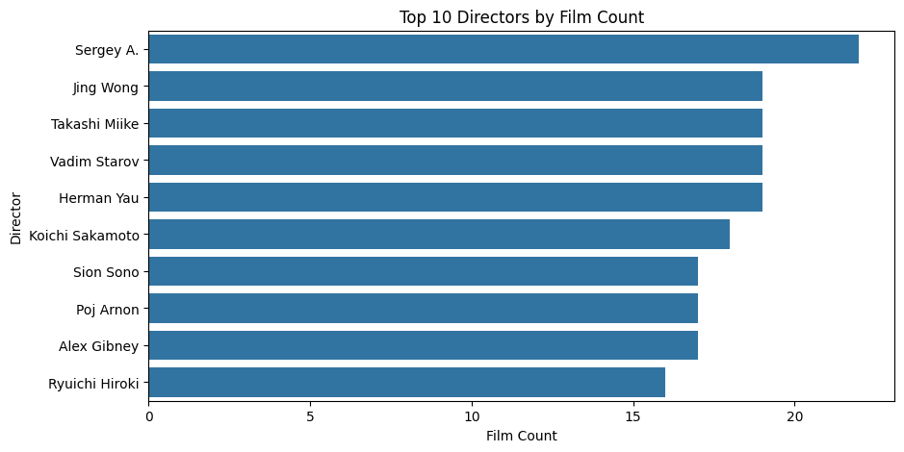
Top 10 Directors by Film Count
Creative Talent Impact:
The most prolific directors by film count are largely from international cinema, with several specializing in genre or regional films

Slide 14
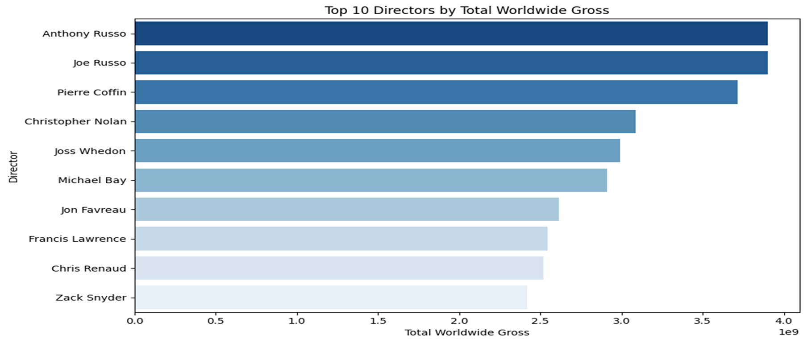
Relationship between Directors and Worldwide Gross
The top-grossing directors are responsible for some of the most successful international blockbusters.
They are often directing sequels or franchise films.
Directors with the highest worldwide gross are associated with major Hollywood franchises and blockbusters,
highlighting the impact of large-scale productions on total revenue.

Slide 15
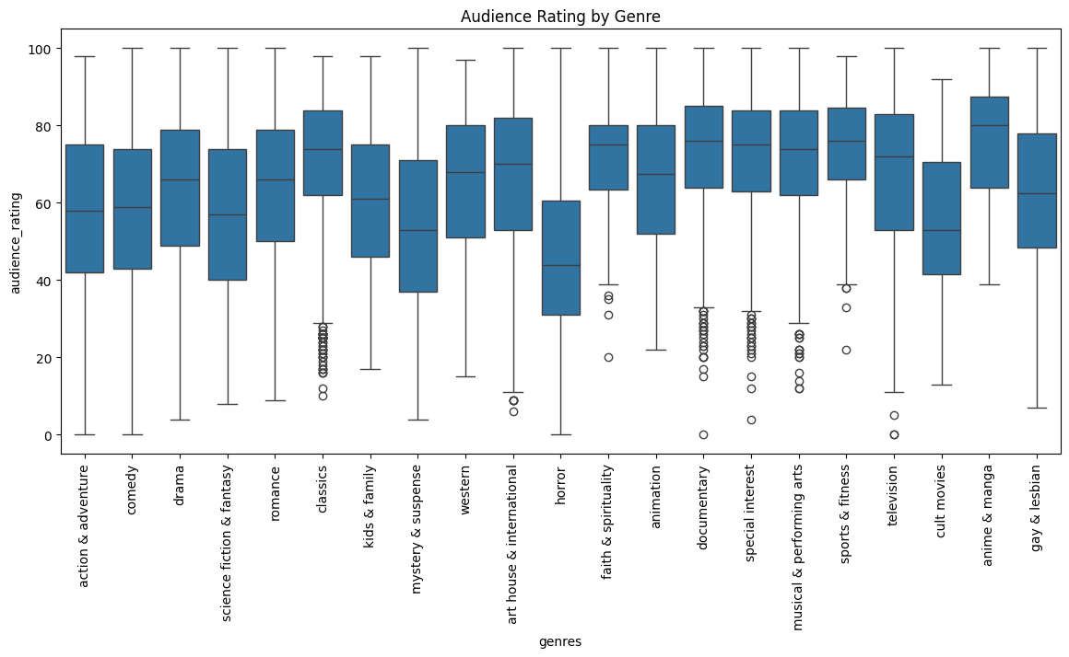
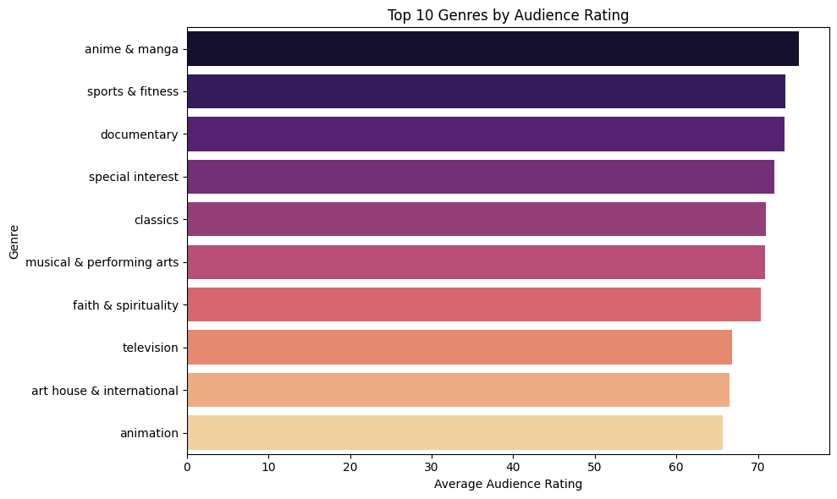
Relationship between Audience Ratings and Genres
Audience Reception:
Audience ratings vary by genre.
Documentaries, musicals, and animation genres tend to have higher median audience ratings
Horror and cult movies often receive lower ratings.

Slide 16
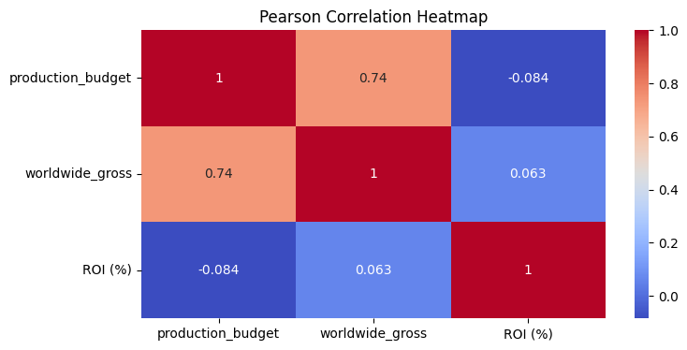
Correlation Analysis
Shows that there is a strong positive correlation between Worldwide Gross and Production budget
There is a negative correlation between the Production budget and the ROI
There is a positive correlation between Worldwide Gross and ROI

Slide 17
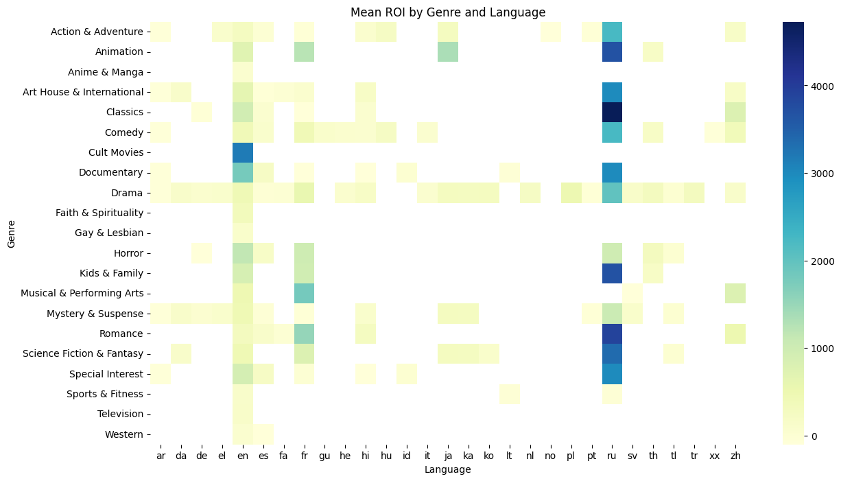
Mean ROI by Genre and Language
Cult movies and Documentaries in English seem to have a high Mean ROI
Classics in Russian also have a high ROI. This shows the presence of a large niche audience.

Slide 18

Recommendations:
Prioritize High-ROI Genres for Strategic Advantage - Genres like Cult Movies, Horror, and Special Interest consistently deliver the highest average Return on Investment (ROI) - especially when produced on lower budgets.
Invest in Animation and Documentary for Strong Critical Reception - Animation and Documentary genres receive some of the highest audience and critic ratings, particularly in English and Japanese. They are also likely to perform well across streaming and international platforms.
Target English-Language Content While Exploring High performing Non-English Niches such as Japanese which have high popularity and ratings in niche genres (like Japanese Animation or Horror).
Collaborate with high-performing directors and producers - Top-grossing directors are mostly linked to franchise and sequel-driven blockbusters. While hiring top-tier directors may not be feasible initially, it would be useful to study their approaches.

Slide 19
Next Steps and Conclusion
We encourage the company to;
Work with experienced consultants who have a strong track record in successful productions. They could improve quality, speed up processes, and provide smart decisions.
Take advantage of popular streaming platforms such as Netflix and Amazon Prime in order to reach a wider audience and increase content accessibility. This will allow the company to tap into diverse markets and demographics.

Slide 20
Thank you!! Gerald Mwangi Rita Nkirote Joan Njuki Peter Chemonges Catherine Maina Leah Mukundi

